Slide 1
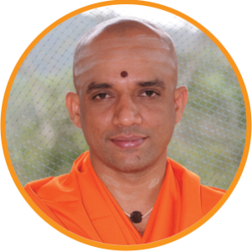
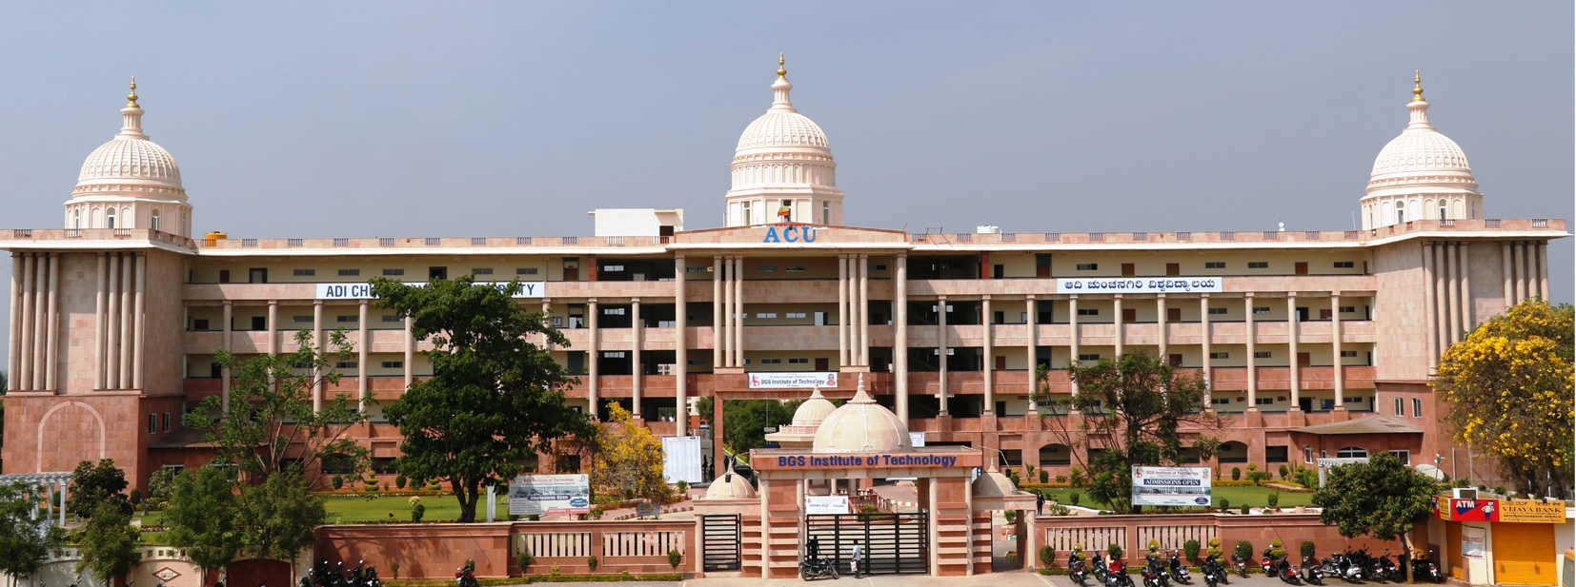
|| Jai Sri Gurudev || BGS INSTITUTE OF TECHNOLOGY BG Nagara – 571448, Nagamangala Taluk, Mandya District
Department of Computer Science & Engineering
Staff and Students Extends
Hearty Welcome to NBA Committee Members

Slide 2
Outline
Introduction
Department Achievements, Recognition & Awards
Criterion 1- Vision, Mission and Program Educational Objectives
Criterion 2 – Program Curriculum and Teaching – Learning Process
Criterion 3 – Program Outcomes and Course Outcomes
Criterion 4 – Students Performance
Criterion 5 – Faculty Information and Contributions
Criterion 6 – Facilities and Technical Support – Teaching Lab and Special Laboratories
Criterion 7 – Continuous Improvement
OBE Process
Conclusion

Slide 3
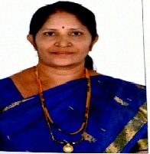
Department and HOD Introduction
The Computer Science & Engineering department was started during 2005 with an intake of 60 and was increased to 90 during 2008.
The MTech Course in CS&E was started during 2013 with an intake of 18 and R & D center was started during 2014.
HOD Profile
Head R & D, Professor Profile
Field | Years
Education | BE (CS&E): Mysore University - 1991 M. Tech (CS&E): VTU - 2005 Ph.D. (CS&E): VTU - 2021
Experience | Teaching: 27 Years
Research Papers | International Journals: 10 Scopus :2 IEEE International Conference: 02
Membership in University Board / Committees | IEEE Member, CSI, MISTE BOS member Chairperson for College Internal Complaint Committee and Cultural Committee .
Grants Received | Title: Establishment of ICT Infrastructure through Digital Library VGST( K-FIST LEVEL 2) –GOK 40L
Department Profile
Department Achievements
Staffs
Achievements
Student
Achievements
Dr. Shashikala S.V MTech, Ph.D.
Professor & Head
Department of CS &E
Alumni Student Achievements

Slide 4
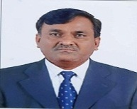
R&D Head, Professor Profile
Name & Designation | Dr. Ravikumar G K MTech, Ph.D. Professor, R&D Head Department of CS&E | Dr. B. K. Raghavendra MTech, Ph.D. Professor Department of CS&E
Education | BE, Bangalore University - 1996 MTech, NITK, Surathkal - 2000 Ph.D., Dr. MGR University - 2013 | BE (CS&E): Bengaluru University, 1994 M. Tech (CS&E): VTU, 2004 Ph. D (CS&E): Dr. MGR University, 2012
Experience | Teaching : 13 Years Industry : 12 Years ( 5 Years in USA) | Teaching & Research: 25+ Years Industry: 2 Years
Research Papers | International Journals : 70 IEEE International Conference : 10 | International Journals: 23 International Conference: 16 National Conference: 20
Patents | International : 08 National : 12 | National : 02
Awards | KSCST IP Award: Appreciation & recognition in the field of Intellectual Property Rights (IPR) under Faculty Category for the Year 2021 by Govt of Karanataka | Best Paper: National Conference, 2011, DBIT, Bengaluru Teacher of Semester: – 2012-13, KSSEM, Bengaluru
Membership in University Board / Committees | Life member of Computer Society of India-CSI (F-8003014 ) Life member of Fellowship of The Institution of Engineers India (F-1262900) Life Member of Indian Society for Technical Education - ISTE ( LM-41034) Senior Member of Institute of Electrical and Electronics Engineers - IEEE (96471611) Life Member of Indian Science Congress Association – (L-38411) National skills registry –NSR (ITPIN- 801047329461) | BoE: VTU, 2013-14 & 2020-21 VTU LIC Member: 2013-14 to 2016-17 VTU Digital Valuation - Chief Coordinator: 2013-14 to 2015-16 BoS: ACU, 2020-21, MISTE
Ph.D. Guidance | Completed: VTU, Belagavi – 05 Nos. Perusing: VTU, Belagavi – 03 Nos. ACU, BG Nagara – 05 Nos. | Submitted: VTU, Belagavi – 01 No. Perusing: VTU, Belagavi – 05 Nos. ACU, BG Nagara – 01 No.
Country Visited | USA, UK | Mauritius
HOD Profile
Head R & D, Professor Profile
Department Profile
Department Achievements
Staffs
Achievements
Student
Achievements
Alumni Student Achievements

Slide 5
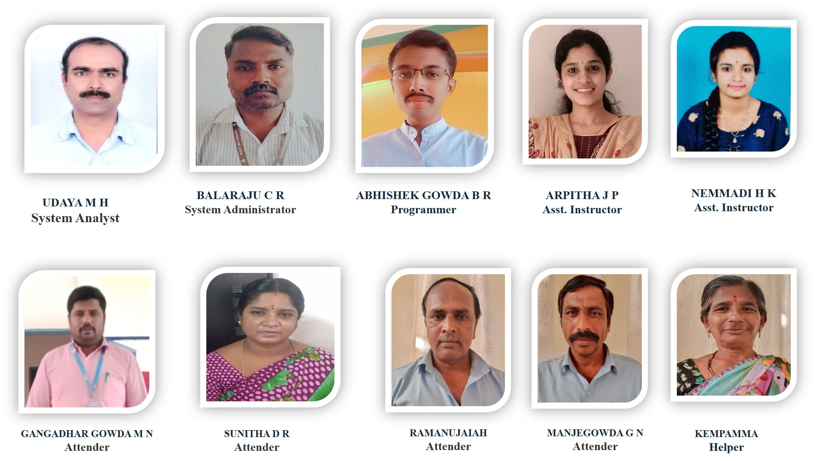
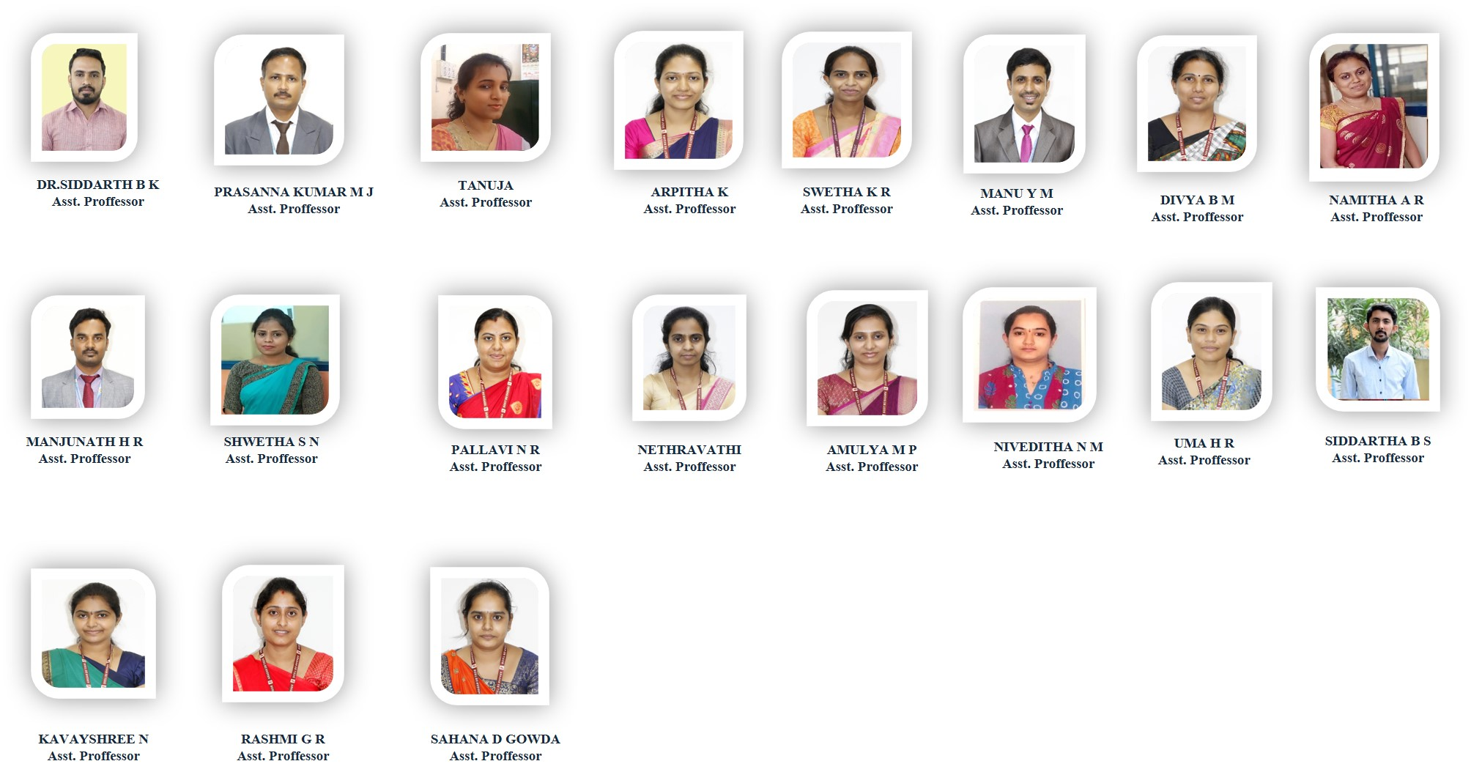
Department Information
Female Faculty – 15
Male Faculty - 07
Faculties Cleared PhD.
Entrance Exams
22
Class Rooms
HOD Profile
04
06
Placements
64%
Professors
Internet Facility
500 Mbps
Seminar Hall
Head R & D, Professor Profile
03
01
Avg. Pass %
In last 3Years
73%
Assistant Professors
HOD Cabin
Laboratories
Department Profile
19
01
10
Enrollment
Ratio
100%
Ph. D Holders
Staffs Room / Cabin
Industry Interaction
Lab (BOT Lab)
04
19
01
Department Achievements
Higher Studies
Central Computing
Lab
12
Faculty Pursuing Ph. D
Department
Library
01
Staffs
Achievements
05
1280
Books
Student
Achievements
Research Lab
Entrepreneur
Paper Publications
Projectors
141
09
01
01
Alumni Student Achievements
Teaching Faculty
Non-Teaching Faculty

Slide 6
Department Achievements
Smart India Hackathon | 2 Batches went to Final round in 2017 1 Batch went to Final round 2019 and stood at 2nd position.
Research Grants | 40L from VGST : Coordinator: Prof. Shashikala S V 2 2.5Cr from GOK: Coordinator: Dr. Ravikumar G K
Patents | International : 10 National: 17
Publications by Faculty | Total : 140 Scopus Indexed : 41
Publications by Students | Around 40 publications by our students and also they wore participated in paper presentation competition held at Chennai
University Rank | 1st rank in VTU & Topper of all toppers with 2 Gold medals at University level.
PhD awarded under guidance of Dr. Ravikumar G K | 2 in house Research Scholars 3 outside Research Scholars
Alumni | Many of our alumni are working around the globe in reputed MNCs
NPTEL /MOOC Courses | Our staffs are continuously doing certification courses
KSCST Fund | 2 student project got fund by GOK. Total 9000Rs.
HOD Profile
Head R & D, Professor Profile
Department Profile
Department Achievements
Staffs
Achievements
Student
Achievements
Alumni Student Achievements

Slide 7
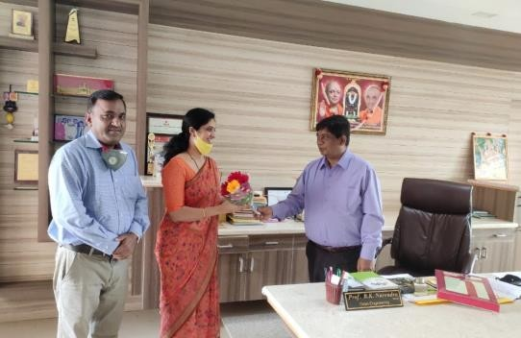
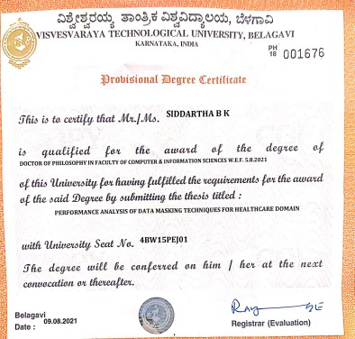
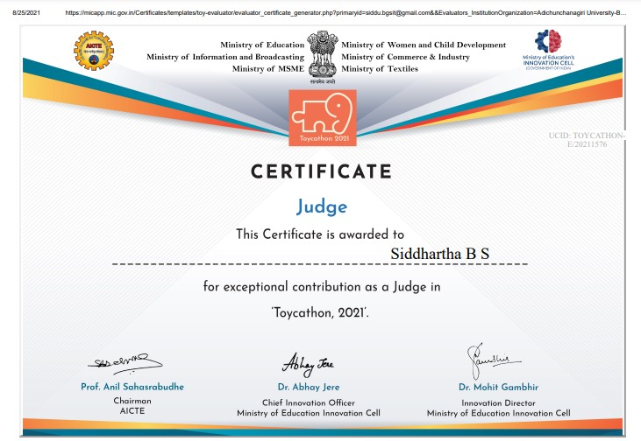
Staffs Achievements
Dr. Shashikala S V has received Rs. 40 Lakhs funds from VGST-K-FIST-L2 Grants, GOK
Dr. Ravikumar G K has been awarded KSCST “IP Award” for the Year 2021 in appreciation & recognition of his contribution in the field of Intellectual Property Rights (IPR) under Faculty Category.
Dr. Ravikumar G K has recognized as IEEE Senior Member.
Faculties have membership in IEEE, ISTE, ISCA, CSI, IAENG, MIE etc.,
5 Research Scholars have awarded Ph.D. under the guidance of Dr. Ravikumar G K during 2019-20 and 2020-21 from VTU, Belagavi.
Staffs are doing MOOC certification course every year.
Staffs are publishing papers in Scopus Indexed Journals.
Patent have filed by the staffs.
Dr . Siddharth B K has awarded PhD.
HOD Profile
Head R & D, Professor Profile
Department Profile
Department Achievements
Staffs
Achievements
Student
Achievements
Alumni Student Achievements

Slide 8
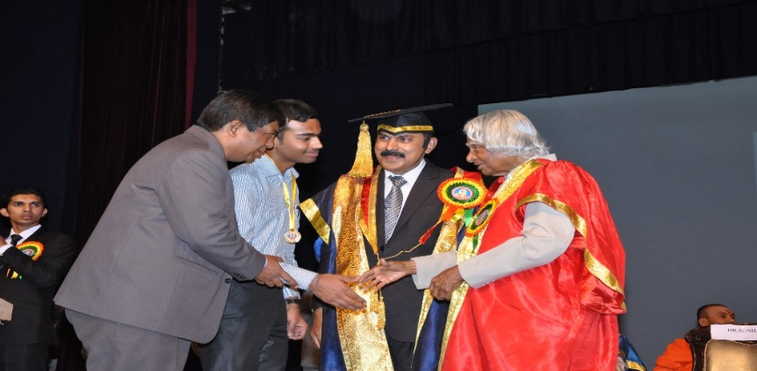
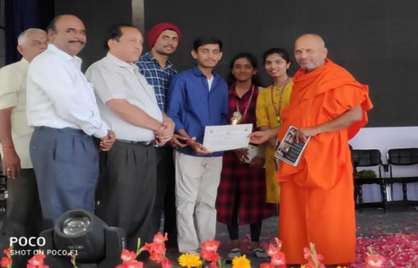
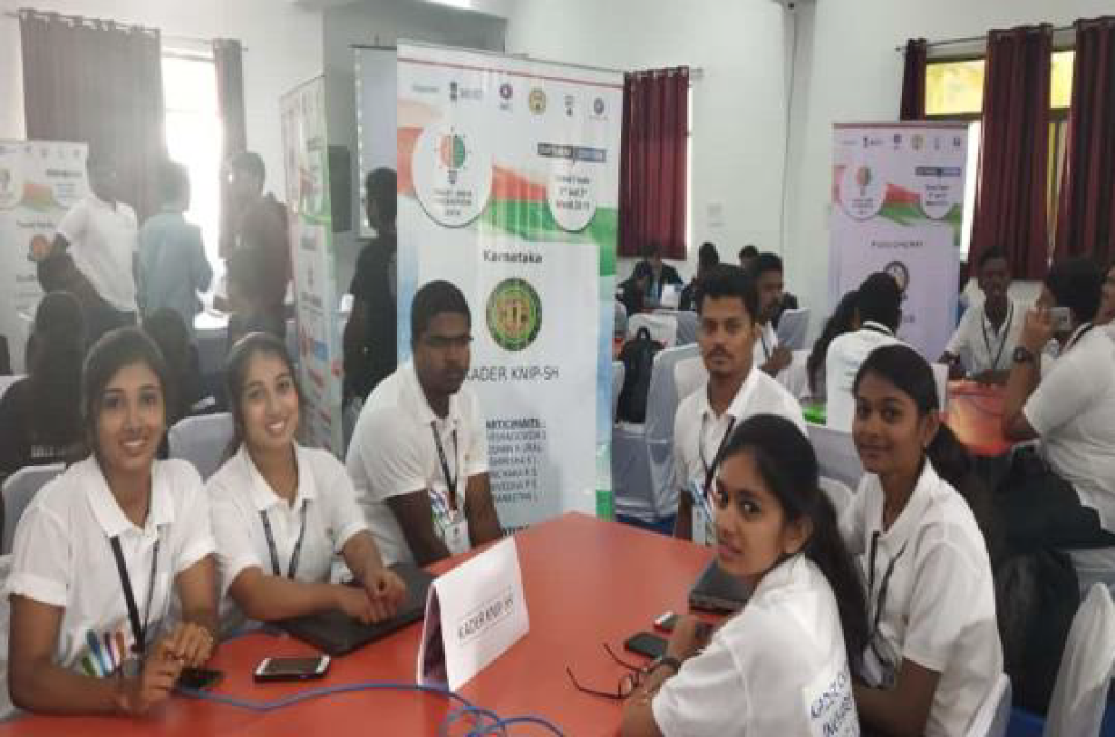
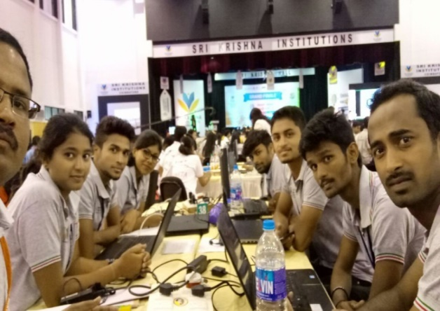
Student Achievements
Umesh C S USN:4BW08CS077 secured 1st Rank and also topper of all toppers at VTU during the academic year 2012-13.
Our students have participated in Smart India Hackathon in 2017 and 2019, secured second place in 2019.
60% Students have placed in MNC every year.
Our students have participated in technical events like International and National conferences, paper presentation, project exhibition etc., every year.
Students are successively participated in Hackathons, TCS Techbytes, JVTM etc.
Students have enrolled membership in CSI & IEEE.
HOD Profile
Head R & D, Professor Profile
Department Profile
Department Achievements
Staffs
Achievements
Student
Achievements
Alumni Student Achievements

Slide 9
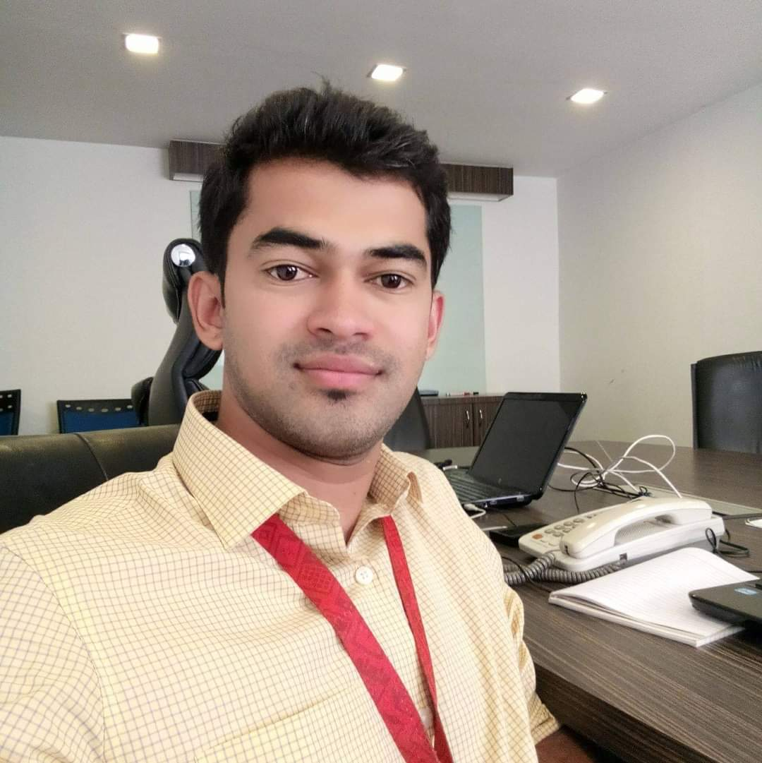
Introduction
HOD Profile
Head R & D, Professor Profile
Umesh C S
Technical Lead, Comviva Technologies, Bangalore
BHAVANI
HP Enterprise, Bengaluru
Darshan
Motivate Media Group , UAE
Department Profile
Department Achievements
Staffs
Achievements
Student
Achievements
Sharath D H Entrepreneur, Mysoft labs Mysore
Dayananda B H KISL Technology, Malaysia
HITHAN
Music director, Kannada film Industry
Alumni Student Achievements

Slide 10
Institute Vision and Mission
Vision
“ BGSIT is committed to the cause of creating tomorrow’s engineers by providing quality education and inculcating ethical values.”
Institute Vision & Mission
Department Vision & Mission
Mission
Imparting quality technical education by nurturing a conducive learning environment.
Offering professional training to meet industry requirements.
Providing education with a moral - cultural base and spiritual touch.
Department PEO’s

Slide 11
Criterion-1: Vision, Mission and PEO
Vision
Institute Vision & Mission
“ To produce engineers by possessing good technical knowledge and ethics through quality education and research.”
Department Vision & Mission
Mission
Achieve excellence by providing good infrastructure and competent faculty.
Strengthening the technical, soft skills, leadership qualities and ethical values to meet the industry requirements.
Facilitate experimental learning through research projects.
Department PEO’s

Slide 12
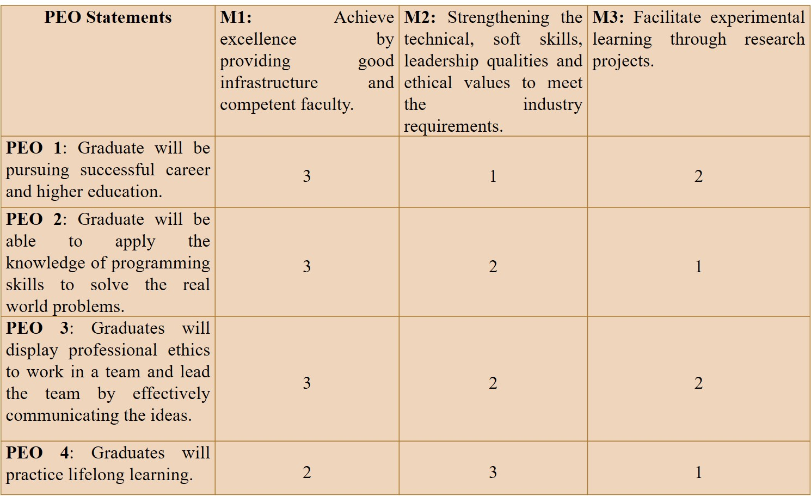
Criterion-1: Vision, Mission and PEO
Program Educational Objectives
Institute Vision & Mission
Graduates will be pursuing successful career and higher education.
Graduates will be able to apply the knowledge of programming skills to solve the real-world problems.
Graduates will display professional ethics to work in a team and lead the team by effectively communicating the ideas.
Graduates will practice lifelong learning.
Department Vision & Mission
Department PEO’s
VM PEO Correlation

Slide 13
Criterion-2 : Program Curriculum & TLP
1. Basic Sciences (BS) | 8
2. Engineering Sciences (ES) | 8
3. Humanities and Social Sciences (HSS) | 4
4. Professional Subjects-Core (PC) | 33
5. Professional Subjects-Elective (PE) | 5
6. Open Elective (OE) | 2
7. Non-Credit Mandatory Course (NCMC) | 2
8. Internship (INT) | 1
9. Project (Pro) | 2
10. Seminar (Sem) | 1
Total | 66
Curriculum
GAP Identification Process
Teaching Learning Process
Industry Interaction

Slide 14
Criterion-2 : Program Curriculum & TLP
Course Allotment
Course Allotted faculty describe the course outcome
NBA
CO-PO and CO-PSO Mapping done by the course coordinator & average is calculated
Program Specific Outcome approved by DAB committee
Curriculum
Program Outcome
GAP Identification Process
If approved by the Module Coordinator / Reviewer & HOD
NO
Teaching Learning Process
YES
Consolidate the CO-PO/PSO mapping for all courses
Industry Interaction
Calculate sum of CO-PO / PSO mapping (S)
Total number of courses addressing each PO/PSO (T)
NO
% of PO’s / PSO’s Correlation >= 20
[G = (S / T) * 100]
Gap exists
YES
Action Taken
No Gap

Slide 15
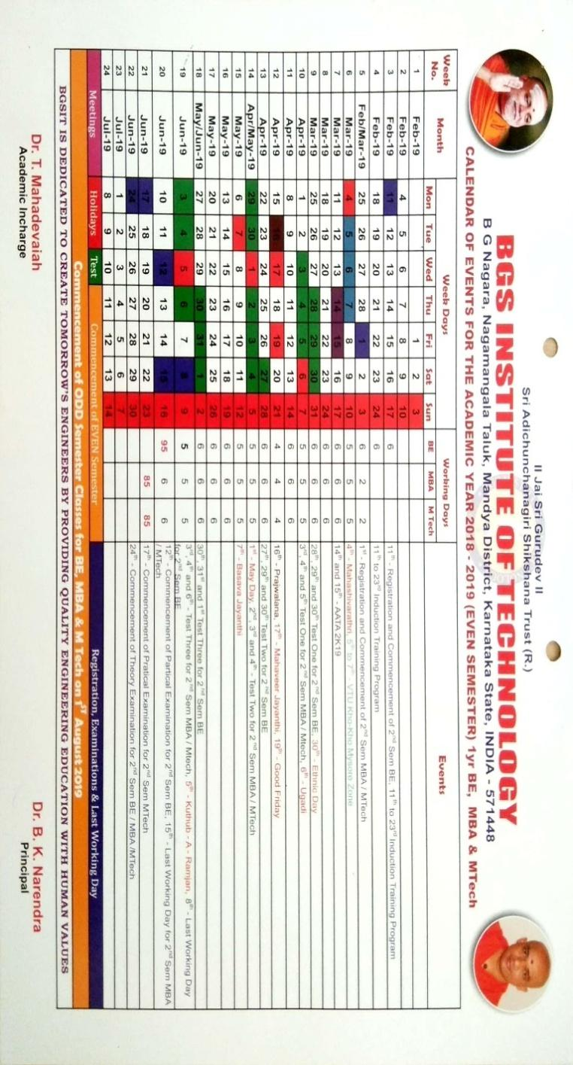
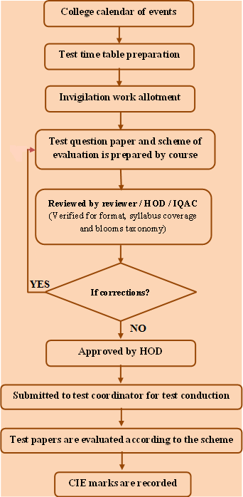
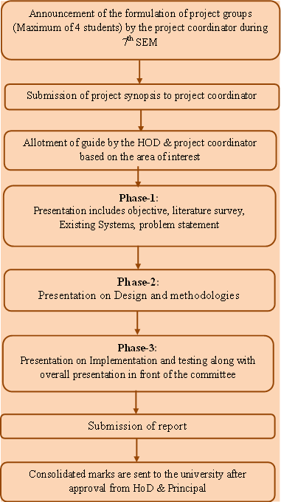
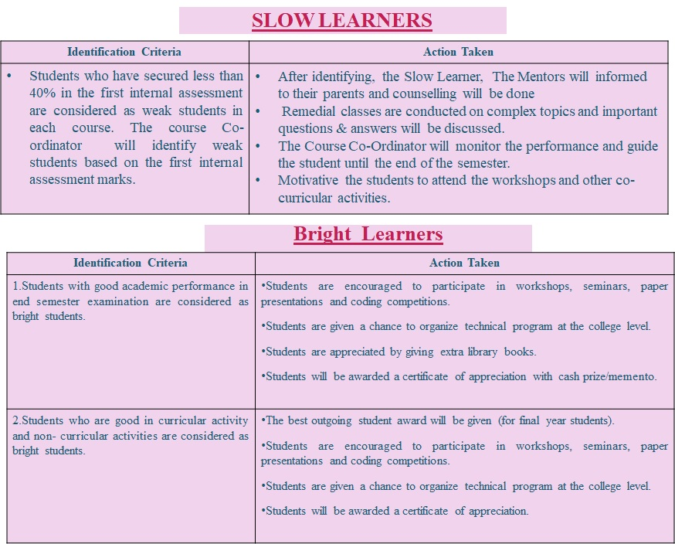
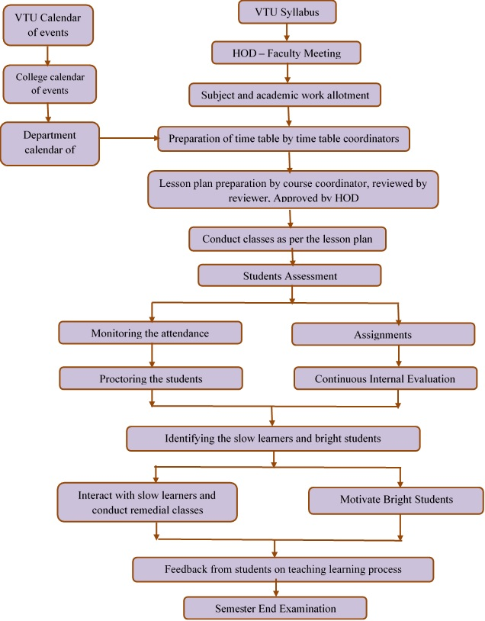
Criterion-2 : Program Curriculum & TLP
Curriculum
GAP Identification Process
Teaching Learning Process
Industry Interaction
Calendar of Events
Fast & Slow Learners
Internal Assessment Process
Project Process

Slide 16
Criterion-2 : Program Curriculum & TLP
Curriculum
MOUs are signed between industries and institutes for establishing the Centre of Excellence.
Internships for the students are arranged.
Industrial visits are organized by the department.
Organizing various seminars, workshops, and conferences in collaborations with industries.
GAP Identification Process
Teaching Learning Process
Industry Interaction
MOU’s
Industry Visit

Slide 17
Criterion-3 : Course Outcome, PO & PSO
Engineering knowledge: Apply the knowledge of mathematics, science, engineering fundamentals, and an engineering specialization to the solution of complex engineering problems.
Problem analysis: Identify, formulate, review research literature, and analyse complex engineering problems reaching substantiated conclusions using first principles of mathematics, natural sciences, and engineering sciences.
Design/development of solutions: Design solutions for complex engineering problems and design system components or processes that meet the specified needs with appropriate consideration for the public health and safety, and the cultural, societal, and environmental considerations.
Conduct investigations of complex problems: Use research-based knowledge and research methods including design of experiments, analysis and interpretation of data, and synthesis of the information to provide valid conclusions.
Modern tool usage: Create, select, and apply appropriate techniques, resources, and modern engineering and it tools including prediction and modelling to complex engineering activities with an understanding of the limitations.
The engineer and society: Apply reasoning informed by the contextual knowledge to assess societal, health, safety, legal and cultural issues and the consequent responsibilities relevant to the professional engineering practice.
Environment and sustainability: Understand the impact of the professional engineering solutions in societal and environmental contexts, and demonstrate the knowledge of, and need for sustainable development.
Ethics: Apply ethical principles and commit to professional ethics and responsibilities and norms of the engineering practice.
Individual and team work: Function effectively as an individual, and as a member or leader in diverse teams, and in multidisciplinary settings.
Communication: Communicate effectively on complex engineering activities with the engineering community and with society at large, such as, being able to comprehend and write effective reports and design documentation, make effective presentations, and give and receive clear instructions.
Project management and finance: Demonstrate knowledge and understanding of the engineering and management principles and apply these to one’s own work, as a member and leader in a team, to manage projects and in multidisciplinary environments.
Life-long learning: Recognize the need for, and have the preparation and ability to engage in independent and life-long learning in the broadest context of technological change.
PSO
PSO - 1 : Ability to apply Mathematical Methodologies, Management Principles and Ethics, Electronics and Embedded Systems and Programming Technologies to solve real time problems.
Assessment Process
Course Outcomes & Its Mappings
PO / PSO Attainment Process
PSO - 2 : Ability to apply software design and development practices to develop software in emerging areas such as Internet of Things, Data Management, Social Networking and Security, Cloud and High-Performance Computing.
CO Attainment
Overall
PO / PSO Attainment
PO’s

Slide 18
Criterion-3 : Course Outcome, PO & PSO
Direct Assessment
Direct method | Form of assessment | Frequency of assessment
CO Attainment | Test | Three Times/Semester
 | Laboratory | Once in a Semester
 | Semester End Exams | Once in a Semester
 | Seminar | Once in a Year
 | Project Work | Twice in a Year
 | Internship | Once in a Year
Indirect Assessment
Indirect method | Form of Assessment |  | Frequency of assessment
Program Exit Survey | Survey Questionnaire |  | End of the Programme
University Course Syllabus
PSO
Course Articulation Matrix
Assessment Process
Mapping of COs to Internal Assessment Questions
Direct Assessment (90%)
Course Outcomes & Its Mappings
Student Scores from Tests and/or Assignment
PO / PSO Attainment
Process
Achieved Attainment from Internal
CO Attainment
60% of weightage for CIE
30% of weightage for SEE
Overall
PO / PSO Attainment
CO Attainment
Indirect Assessment (10%)
Overall Assessment (100%)

Slide 19
Criterion-3 : Course Outcome, PO & PSO
Sl. No | Assessment Method | Max. Marks | Course Outcome
 |  |  | Target Levels
1 | Internal Assessment (IA) | 15+5 | ≥70% - Target3 >60% and <70% - Target 2 >50% and <60% - Target 1 | ≥70% - Target3 >60% and <70% - Target 2 >50% and <60% - Target 1
2 | Lab Internal Assessment | 20 | ≥80% - Target3 >70% and <80% - Target 2 >60% and <70% - Target 1
3 | Semester End Examination (SEE) | 80 (Theory) | ≥70% - Target3 >60% and <70% - Target 2 >50% and <60% - Target 1
 |  | 80 (Practical) | ≥80% - Target3 >70% and <80% - Target 2 >60% and <70% - Target 1
4 | Project Work Phase - I Project Work (Internal and External) | 100 | ≥80% - Target3 >70% and <80% - Target 2 >60% and <70% - Target 1
5 | Internship/ Professional Practice (Internal and External) | 50 | ≥80% - Target3 >70% and <80% - Target 2 >60% and <70% - Target 1
6 | Seminar | 100 | ≥80% - Target3 >70% and <80% - Target 2 >60% and <70% - Target 1
PSO
Assessment Process
Course Outcomes & Its Mappings
PO / PSO Attainment
Process
CO Attainment
Overall
PO / PSO Attainment

Slide 20
Criterion-3 : Course Outcome, PO & PSO
Course Outcome | Subject: Operating System Subject Code: 15CS64 Semester: 6
CO 1 | Explain the different environments of the operating systems.
CO 2 | Compare different process scheduling algorithms and interpret the concurrency problem to overcome it by using different solutions.
CO 3 | Estimate and utilize memory management approaches and Understand the structure, organization of file system
CO 4 | Analyze the structure of secondary storage and apply the virtual memory management strategies, principles of protection
PSO
Assessment Process
Course Outcomes & Its Mappings
PO / PSO Attainment
Process
CO Attainment
CO/PO | PO1 | PO2 | PO3 | PO4 | PO5 | PO6 | PO7 | PO8 | PO9 | PO10 | PO11 | PO12 | PSO1 | PSO2
CO 1 | 3 | 2 | 2 | 1 |  |  |  |  |  |  |  |  |  | 2
CO 2 | 3 | 2 | 2 |  |  |  |  |  |  |  |  |  | 1 | 2
CO 3 | 3 | 2 | 2 | 2 |  |  |  |  |  |  |  |  | 1 | 2
CO 4 | 3 | 2 | 2 |  |  |  |  |  |  |  |  |  | 1 | 2
Average | 3 | 2 | 2 | 1.5 |  |  |  |  |  |  |  |  | 1 | 2
Overall
PO / PSO Attainment
Correlation Level:
3. High
2. Moderate
1. Low

Slide 21
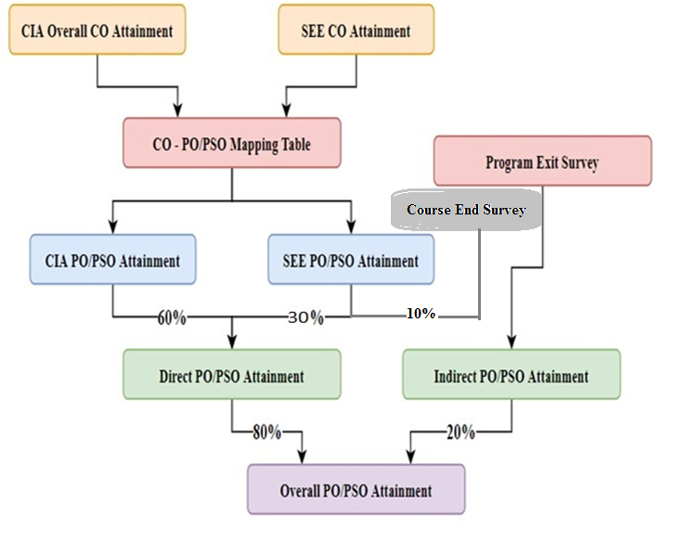
Criterion-3 : Course Outcome, PO & PSO
PSO
Direct Assessment Tools
Course Outcomes & Its Mappings
PO / PSO Attainment
Process
CO Attainment
Overall
PO / PSO Attainment

Slide 22
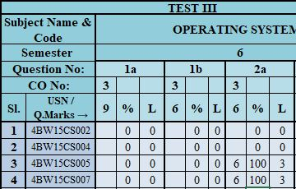
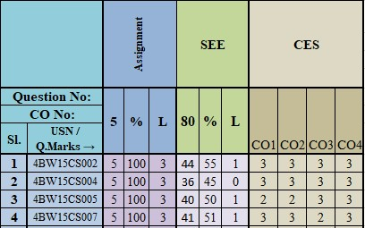
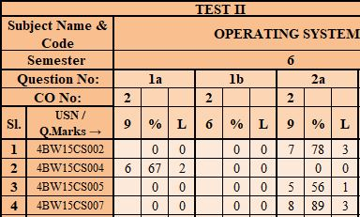
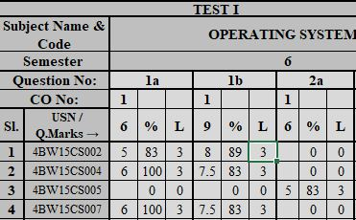
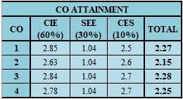
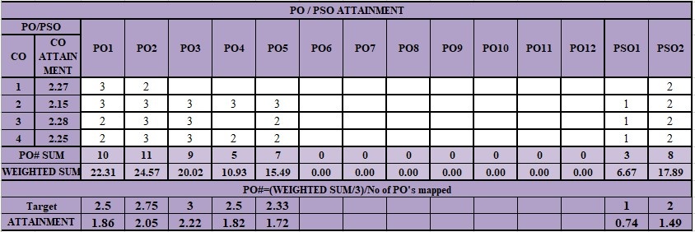
Criterion-3 : Course Outcome, PO & PSO
PSO
Direct Assessment Tools
Course Outcomes & Its Mappings
PO / PSO Attainment
Process
CO Attainment
Overall
PO / PSO Attainment

Slide 23
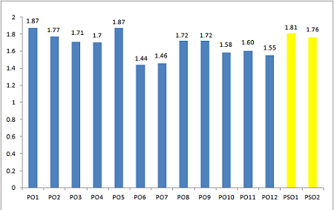
Criterion-3 : Course Outcome, PO & PSO
PSO
Course | PO1 | PO2 | PO3 | PO4 | PO5 | PO6 | PO7 | PO8 | PO9 | PO10 | PO11 | PSO1 | PSO2
Direct Attainment | 1.74 | 1.59 | 1.43 | 1.49 | 1.78 | 1.21 | 1.26 | 1.56 | 1.41 | 1.41 | 1.29 | 1.42 | 1.53
Indirect Attainment (Program Exit Survey) | 2.38 | 2.47 | 2.81 | 2.55 | 2.25 | 2.38 | 2.26 | 2.35 | 2.24 | 2.24 | 2.61 | 2.36 | 2.42
Final Attainment | 1.87 | 1.77 | 1.71 | 1.70 | 1.87 | 1.44 | 1.46 | 1.72 | 1.58 | 1.58 | 1.55 | 1.61 | 1.71
Direct Assessment Tools
Course Outcomes & Its Mappings
PO / PSO Attainment
Process
CO Attainment
Overall
PO / PSO Attainment
Overall Comparison

Slide 24
Criterion 4: Student’s Performance
Enrollment Ratio
Success Rate
Academic Performance
After Graduation
Professional Activities
News Letters

Slide 25
Criterion 4: Student’s Performance
Enrollment Ratio
Success Rate
Average SI 36%
Without Backlog
Academic Performance
After Graduation
Professional Activities
News Letters
Average SI 73%
With\Without Backlog

Slide 26
Criterion 4: Student’s Performance
Enrollment Ratio
Success Rate
Average API 6.78
3rd Year
Academic Performance
After Graduation
Professional Activities
Average API 6.42
News Letters
2nd Year

Slide 27
Criterion 4: Student’s Performance
Enrollment Ratio
Success Rate
Academic Performance
After Graduation
Professional Activities
News Letters

Slide 28
Criterion 4: Student’s Performance
IEEE (Institute of Electrical and Electronics Engineering)
Enrollment Ratio
Success Rate
CSI (Computer Society Of India)
Academic Performance
ISTE (Indian Society For Technical Education)
After Graduation
Innovation and Science Club
Professional Activities
Students are encouraged to
Attend Workshops
Participate in Inter Institute Competitions
Undergo Internships
Take up Technical Events
News Letters

Slide 29
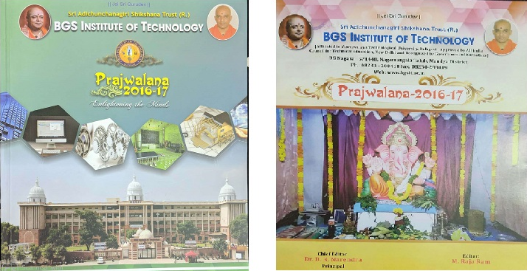
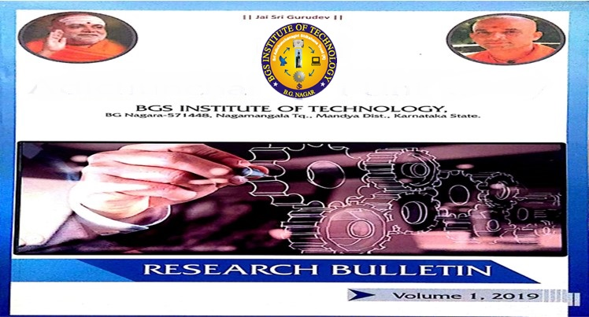
Criterion 4: Student’s Performance
Enrollment Ratio
Success Rate
Academic Performance
After Graduation
College Magazine
College Magazine
Professional Activities
News Letters
Department News Letter
Research Bulletin

Slide 30
Criterion-5 : Faculty Information & Contribution
Faculty Details
SFR
Innovation in Teaching
Participation in FDP
Research Details
Faculty Publications
Sponsored Projects

Slide 31
Criterion-5 : Faculty Information & Contribution
Faculty Retention-97.5%
Faculty Details
SFR
Innovation in Teaching
Participation in FDP
Research Details
Faculty Publications
Sponsored Projects
Faculty Appraisal

Slide 32
Criterion-5 : Faculty Information & Contribution
Faculty Details
SFR
Innovation in Teaching
Interactive Classroom Teaching
Code Demonstration
Collaborative Learning
Participation in FDP
Research Details
Faculty Publications
Sponsored Projects
Power Point Presentation
GD, Quiz, Seminar
Faculty Appraisal
Flip Class

Slide 33
Criterion-5 : Faculty Information & Contribution
Faculty Details
SFR
Innovation in Teaching
Participation in FDP
Research Details
Faculty Publications
Sponsored Projects
Faculty Appraisal

Slide 34
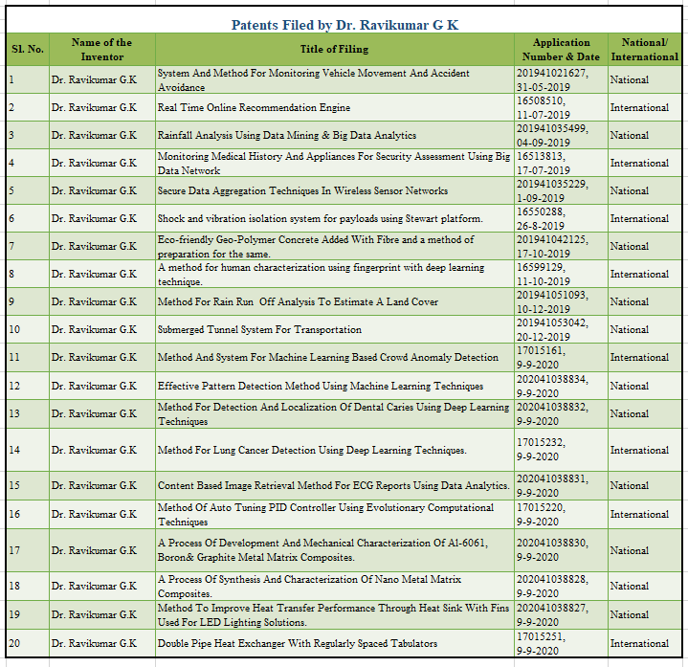
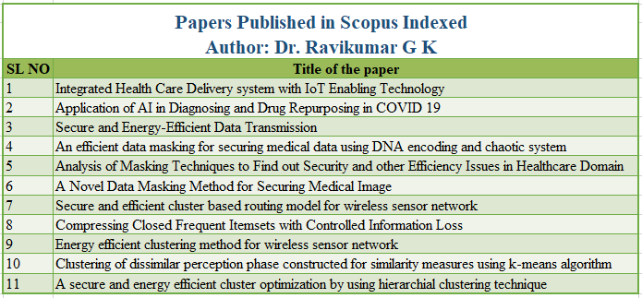
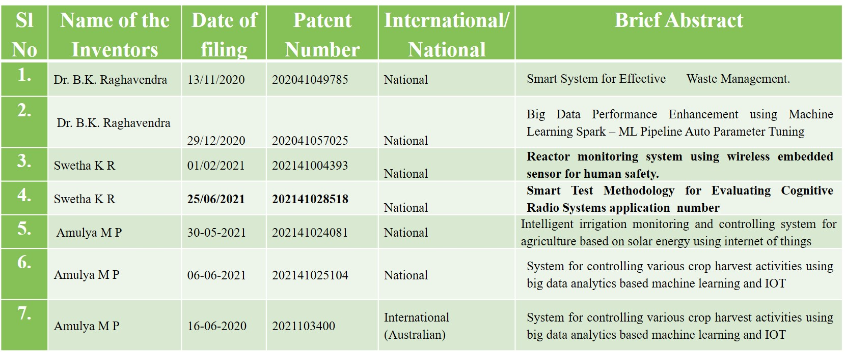
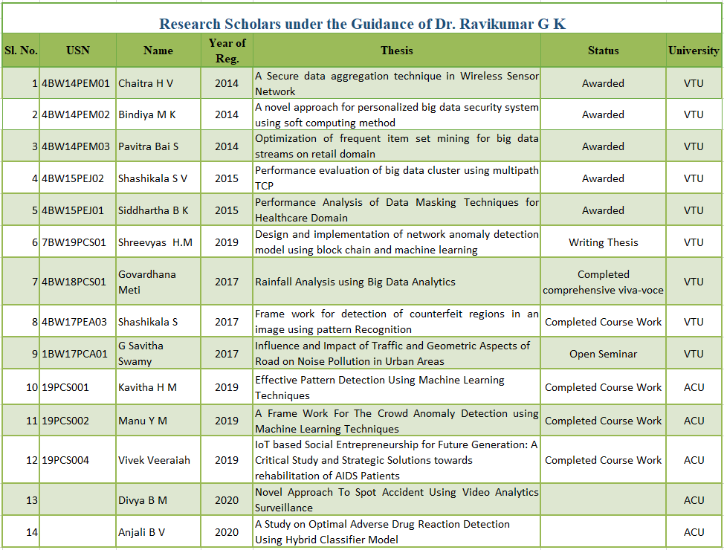
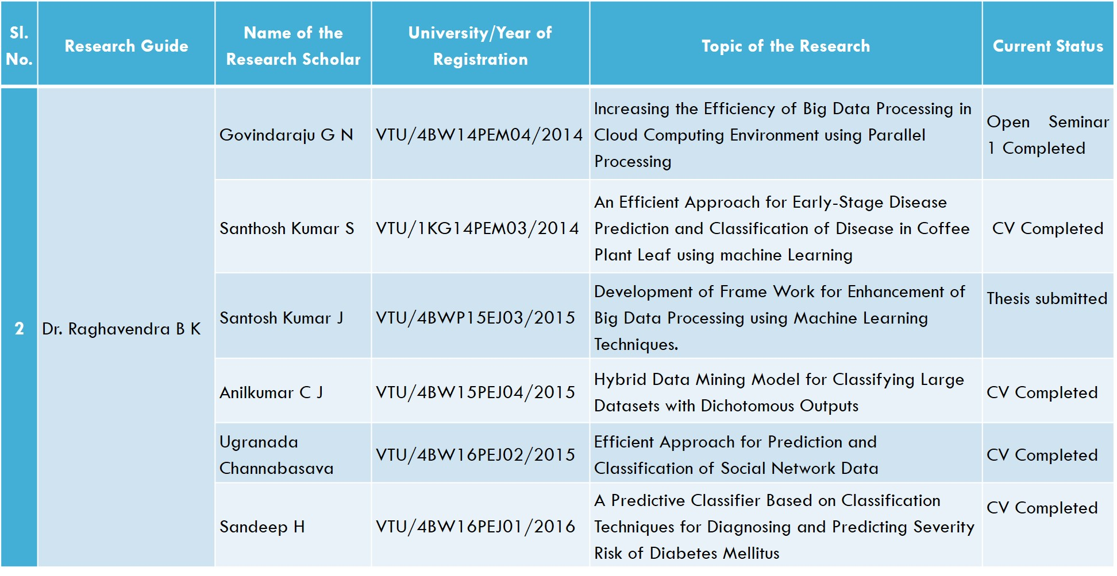
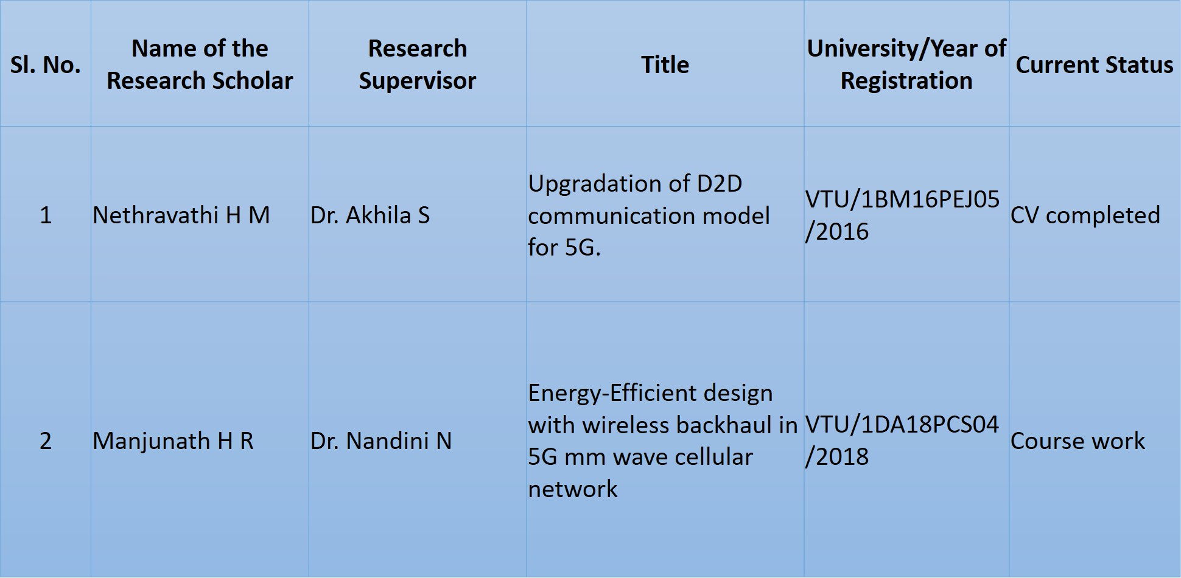
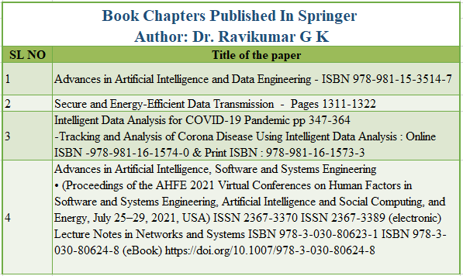
Criterion-5 : Faculty Information & Contribution
Faculty Details
Guide | VTU | Total
Dr. Ravikumar G K | 3 | 3
Dr. B K Raghavendra | 6 | 6
SFR
Innovation in Teaching
Participation in FDP
Research Details
Research Scholar Under Dr. Ravikumar G K
Faculty Publications
Dr. Ravikumar G K
Patent
Sponsored Projects
Research Scholar Under Dr. B. K. Raghavendra
Other Professor & Faculty
Patent
Dr. Ravikumar G K
Published In Scopus Index & Springer
Faculty Appraisal
Research Scholar outside our R&D

Slide 35
Criterion-5 : Faculty Information & Contribution
Faculty Details
SFR
Innovation in Teaching
Participation in FDP
Research Details
Faculty Publications
Sponsored Projects
Faculty Appraisal
Publication Details

Slide 36
Criterion-5 : Faculty Information & Contribution
Faculty Details
Sl. No | Project tittle | Funding Agency | Amount | Coordinator | Duration | Sanction
1 | Establishment of ICT Infrastructure through Digital Library | VGST (K-FIST LEVEL 2) | 20 Lakhs | Prof. Shashikala S.V | 2014-15 | 2014-15
 |  |  | 20 Lakhs | Prof. Shashikala S.V |  | 2018-19
3 | NAIN | KITS, State Govt. of Karnataka | 2.5 Crores | Dr.Ravikumar G K | 2020-2026 | 2020
SFR
Innovation in Teaching
Participation in FDP
Research Details
Faculty Publications
Sponsored Projects
Faculty Appraisal

Slide 37
Criterion-5 : Faculty Information & Contribution
Faculty fills the appraisal form for one academic year and undergoes self-evaluation
Faculty Details
HOD reviews the self-appraisal forms and gives his opinion by assigning the marks
SFR
After HOD review, HOD will forward the same to the head of the institution
Innovation in Teaching
Head of the institution will form the committee for further review
Participation in FDP
Committee members evaluate and verify the documents submitted by the faculty
Research Details
Principal takes the final decision in consultation with HOD in recommendation faculty award/promotion/ increment/rectification/lay-off
Faculty Publications
Overall Rating>= 85%
Overall Rating<= 59%
Sponsored Projects
Letter of Appreciation
HOD Suggests action plan to the faculty member
Recommended for faculty Awards
Recommended to undergo Training Programs
Faculty Appraisal

Slide 38
Criterion-6 : Facilities & Technical Support
Laboratory Details
Name | No. of Systems | System Specification
CP Lab | 30 | Hardware: HCL Intel Pentium Core 2 duo, 512 MB RAM, 80GB HDD, 1.44MB FDD, 15” TFT Monitor, MM Key Board, Optical PS2 Mouse Operating System: Fedora 14/ Windows 7 Softwares: vi Editor/ Turbo C++
ADE / MP&MC Lab | 26 | Hardware: Acer veriton Intel Core 2 duo, 2 GB RAM, 320GB HDD, 18.5” TFT Monitor, MM Key Board, Optical PS2 Mouse CRT, Digital Trainer kits, Multimeter, Microprocessor interfaces, Stepper motor kit, LCD kit Operating System: Windows 7 Softwares: Xilnx, Multim, MASM and Keil
DS / ADA Lab | 26 | Hardware: Acer veriton Intel Core 2 duo, 2 GB RAM, 320 GB HDD, 18.5” TFT Monitor, MM Key Board, Optical PS2 Mouse Operating System: Fedora 14/ Windows 7 Softwares: vi Editor + C compiler/ Turbo C++
DMS / OOPs Lab | 25 | Hardware: Acer Intel Core i5, 4 GB RAM, 500 GB HDD, 19.5” LCD Monitor, MM Key Board, Optical PS2 Mouse Operating System: Fedora 14/ Windows 7 Softwares: vi Editor + C compiler/ Turbo C++, MiniTab
Technical Staff Name & Qualification
Additional Facility
Safety Measures
Ambience
Project Laboratories

Slide 39
Criterion-6 : Facilities & Technical Support
Name | No. of Systems | System Specification
CN /SS &OS Lab | 26 | Hardware: DELL Desktop, Intel Core i3 Processor, 4 GB RAM, 200 GB HDD, 18.5” LED Monitor Operating System: Fedora 14/ Windows 7 Softwares: vi Editor, Eclipse IDE JAVA – JDK,NS2
DBMS/CG Lab | 27 | Hardware: LENOVO Desktop, Intel Core i5 processor, 4 GB RAM, 500 GB HDD, DVD Reader, 19.5” LED Monitor Operating System: Windows 7 Softwares: MySQL community server, Microsoft Visual Studio 2019, Glut libraries
ML/ Project Lab | 43 | Hardware: LENOVO Desktop, Intel Core i5 processor, 4 GB RAM, 500 GB HDD, DVD Writer, 19.5” LED Monitor Dell Optiplex, Intel Core i5 processor, 4 GB RAM, 500 GB HDD, DVD Writer, 19.5” LED Monitor Dell Optiplex, Intel Core 2 Duo processor, 2 GB RAM, 200 GB HDD, 19.5” LED Monitor Operating System: Windows 7 Softwares: Anaconda Python and Students are allowed to install soft wares according the requirements of their project
Web Technology Lab | 27 | Hardware: LENOVO Desktop, Intel Core i5 processor, 4 GB RAM, 500 GB HDD, DVD Writer, 19.5” LED Monitor Operating System: Windows 7 Software: Sublime Text Web browser Xampp (PHP)
Laboratory Details
Technical Staff Name & Qualification
Additional Facility
Safety Measures
Ambience
Project Laboratories

Slide 40
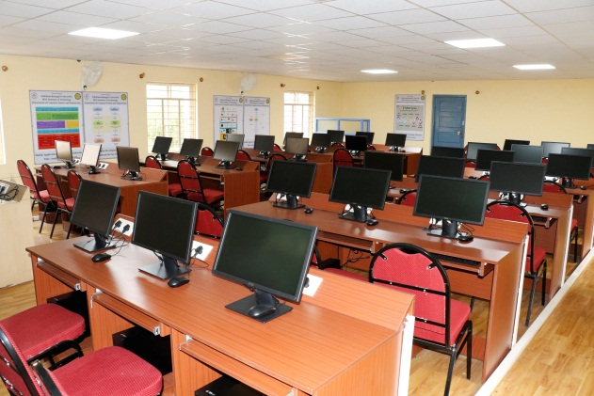
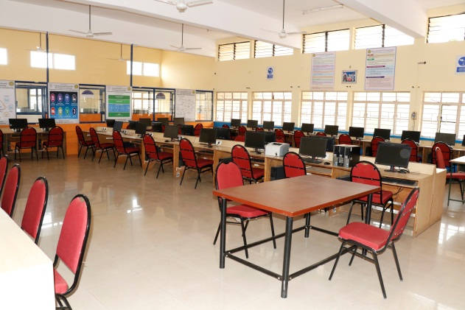
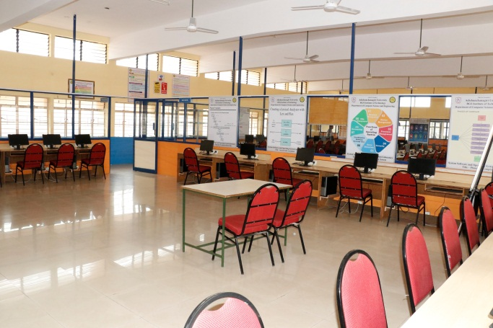
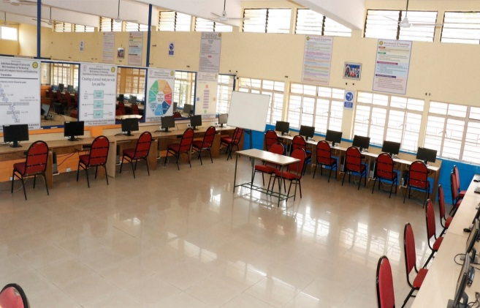
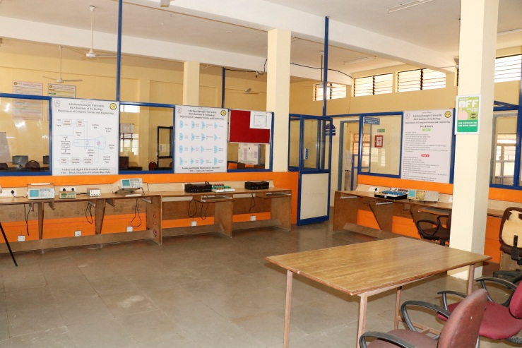
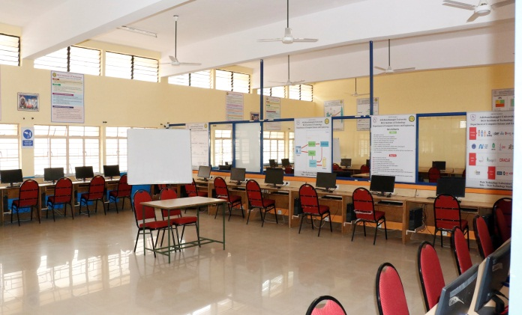
Criterion-6 : Facilities & Technical Support
Laboratory Details
Technical Staff Name & Qualification
JAVA & PHYTHON LAB /
MAD LAB
ML LAB /
PROJECT LAB
CN LAB /
SS & OS LAB
Additional Facility
Safety Measures
Ambience
WEB LAB /
PROJECT LAB
DBMS LAB /
CG LAB
ADE LAB /
MP & MC LAB

Slide 41
List of Technical Supporting Staff with their Designation and Qualification
Criterion-6 : Facilities & Technical Support
Sl. No. | Name of the Technical staff | Designation | Qualification | Experience
1 | Mr. Balaraju C R | System Administrator | B.Sc in Computer Science | 15 Years
2 | Mr. Uday M H | System Analyst | M.Sc in Information Technology | 25 Years
3 | Mr. Abhishek Gowda B R | Programmer | Bachelor of Engineering | 2 Years
4 | Ms. Arpitha J P | Assistant Instructor | PUC, (Diploma) | 3 Years
5 | Ms. Nemmadi H K | Assistant Instructor | (Diploma) | 0.5 Years
Laboratory Details
Technical Staff Name & Qualification
Additional Facility
Safety Measures
Sl. No. | Name of the Non- Technical staff | Designation | Qualification | Experience
1 | Mr. Gangadhar Gowda M N | Attender | 9th Std | 17 Years
2 | Mrs. Sunitha D R | Attender | SSLC | 03 Years
3 | Mrs. Kempamma | Attender | - | 06 Years
4 | Mrs. Manjula B S | Attender | SSLC | 07 Years
5 | Mr. Manjegowda G N | Attender | SSLC | 17 Years
6 | Mr. Ramanujaiah | Attender | SSLC | 22 Years
Ambience
Project Laboratories

Slide 42
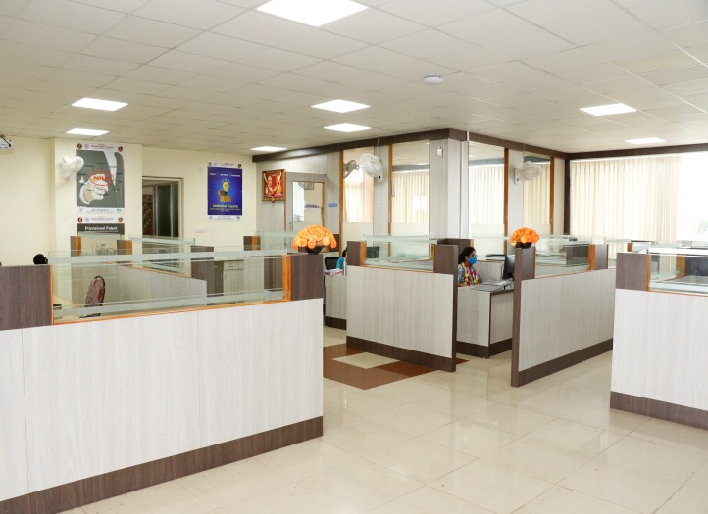
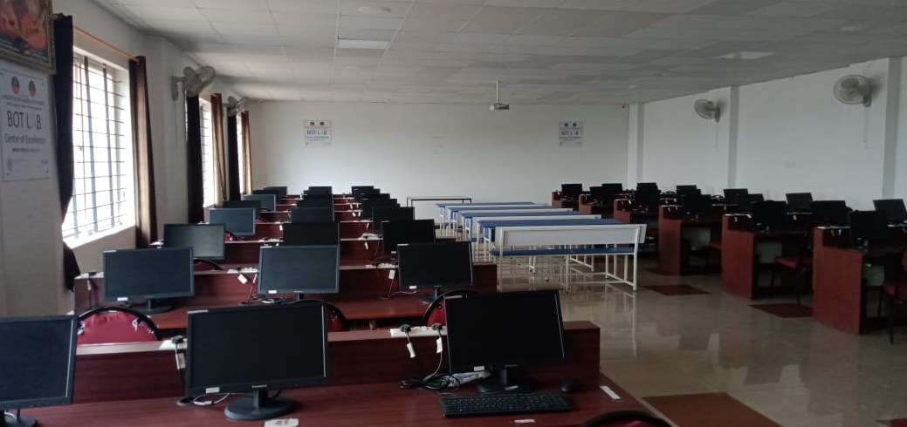
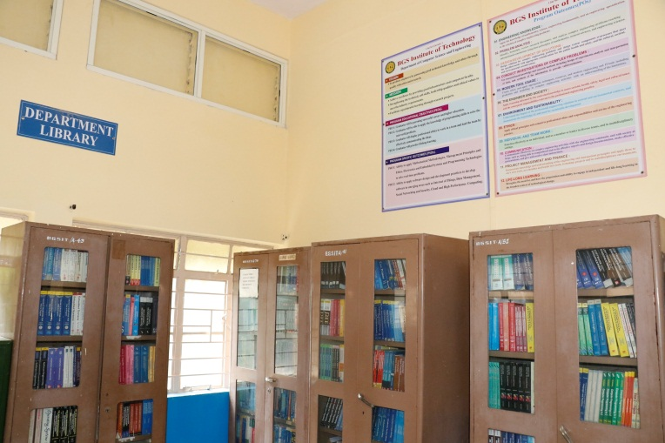
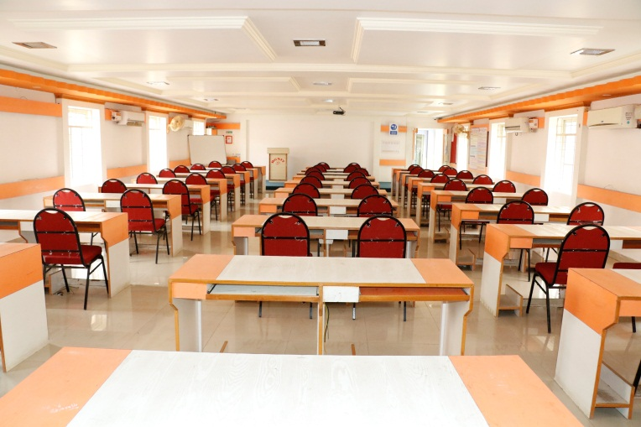
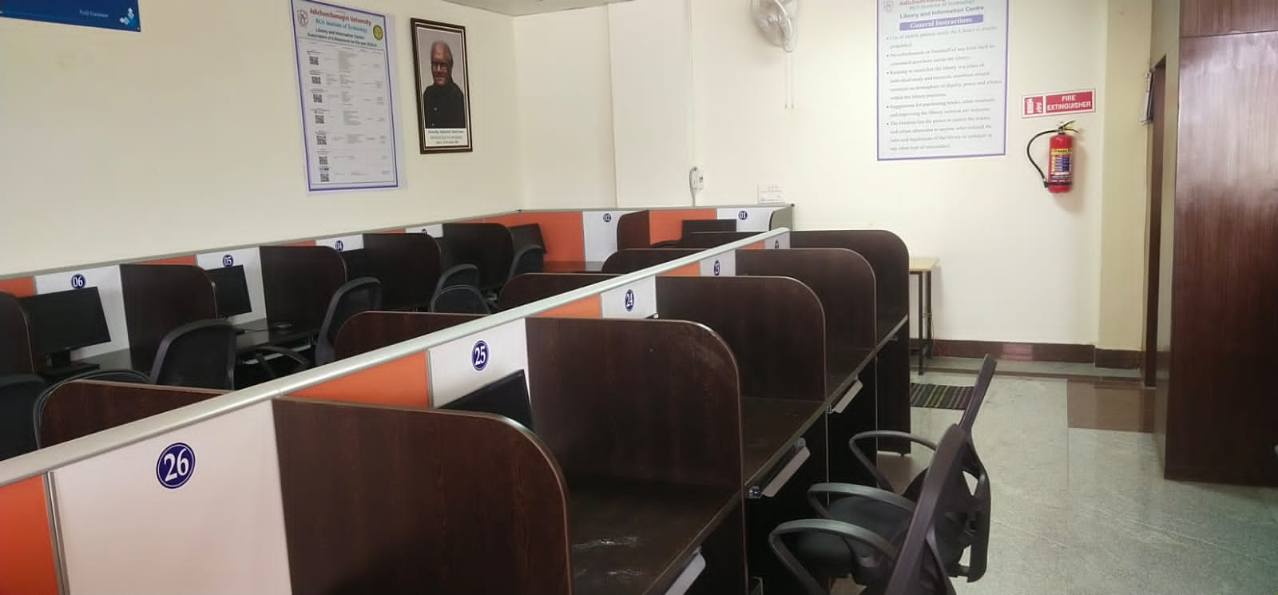
Criterion-6 : Facilities & Technical Support
Laboratory Details
Additional Facility
Safety Measures
Research and Development Centre
BOT Lab
(Industry Supported Lab)
Ambience
Central Computing Lab
Project Laboratories
Department Library
Department Seminar Hall
Digital Library

Slide 43
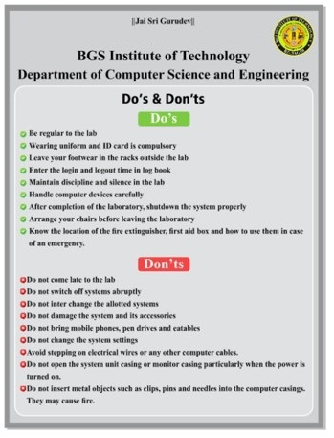
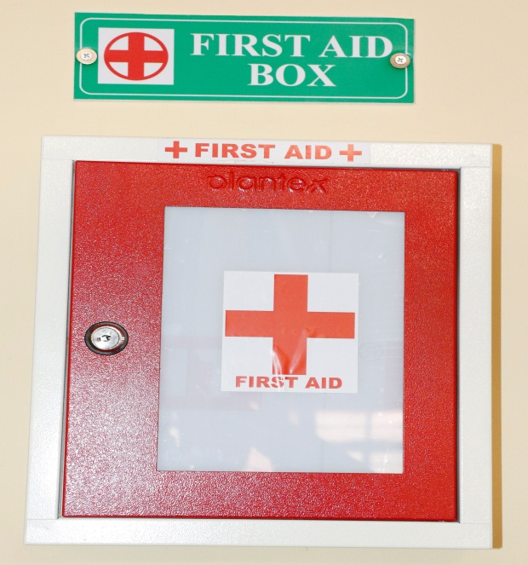
Criterion-6 : Facilities & Technical Support
Laboratory Details
Department Corridors, Classrooms, Meeting Hall, Staff Rooms are covered with CCTV surveillance.
All the Laboratories are equipped with First Aid Kits.
Fire Extinguishers are placed at the relevant places in the corridors.
All Laboratories are displayed with Do’s & Don’ts safety boards.
Additional Facility
Safety Measures
Ambience

Slide 44
Criterion-6 : Facilities & Technical Support
Laboratory Details
Additional Facility
Safety Measures
Ambience
Project Laboratories

Slide 45
Criterion-6 : Facilities & Technical Support
Laboratory Details
Additional Facility
Safety Measures
Ambience
Project Laboratories

Slide 46
Criterion-6 : Facilities & Technical Support
PROJECT LABORATORY The project laboratory is equipped with high end systems with legal software's for conduction of project works.
Laboratory Details
Additional Facility
Safety Measures
Sl. No. | Name of the Software installed
1. | Turbo C/C++
2. | Fedora 14
3. | Windows
4. | JDK1.6 Microsoft Visual Studio 2010
5. | Eclipse
6. | Apache Tomcat server
7. | MySql
8. | Python & Anaconda
9. | Visual Basic
10. | Adobe Reader
11. | Students are allowed to install software's according the requirements of their project
Ambience
Project Laboratories

Slide 47
Criterion-7 : Continuous Improvement
PO-PSO Direct Attainment
Continuous Improvement Process
Academic Audit
Improvement in Placement
Quality of Admitted Students

Slide 48
Criterion-7 : Continuous Improvement
PO-PSO Direct Attainment
Continuous Improvement Process
Academic Audit
Improvement in Placement
Quality of Admitted Students

Slide 49
Criterion-7 : Continuous Improvement
Internal Audit
External Audit
The internal academic audit will be done once in a semester and giving their feedback:
The Internal audit committee members are
Principal
Academic incharge of the Institute
Head of the department
Senior faculty from other department
PO-PSO Direct Attainment
External Academic audit
AICTE
Continuous Improvement Process
LIC
Academic Audit
Principal
Improvement in Placement
All Departments
The committee will verify the Course file once in a semester, the course file includes:
Calendar of events
Time Table
Syllabus
Lesson Plan
CO-PO Mapping
Course materials
Quality of Admitted Students
If any deficiency compliance
YES
NO
Continuation of Affiliation

Slide 50
Criterion-7 : Continuous Improvement
PO-PSO Direct Attainment
Continuous Improvement Process
Academic Audit
Improvement in Placement
Quality of Admitted Students

Slide 51
Criterion-7 : Continuous Improvement
PO-PSO Direct Attainment
Continuous Improvement Process
Academic Audit
Improvement in Placement
Quality of Admitted Students

Slide 52
OBE Process & It’s Adoption in the Department

Slide 53
Outcome Based Education
OBE is an educational process that focuses on what students can do or the qualities they should develop after they are taught.
OBE involves the restructuring of curriculum, assessment and reporting practices in education to reflect the achievement of high order learning and mastery rather than accumulation of course credits.
Understanding fundamentals very well, and learning new skills/competencies that would enable individuals to cope with the demands of the rapidly changing workplace.
Prepare global engineers who will have to solve problems and shoulder challenges which are not even known today!!
Benefits of OBE:
More directed & coherent curriculum.
Graduates will be more “relevant” to industry & other stakeholders (more well
rounded graduates)
Continuous Quality Improvement (CQI) is in place.
53
53

Slide 54
Outcome Based Education
Framework for Outcome Based Education
Institute Vision and Mission
Program Outcomes
Washington Accord
Department Vision and Mission
Course Outcomes
Program
Teaching Learning & Evaluation
Program Educational Objectives
Graduate
Engineer
54
54

Slide 55
Outcome Based Education
OBE Measuring Process
Program & Course Outcomes
Program Education Outcomes
Input
Process
Teaching Staff
Curriculum
Labs
Other Resource
Teaching & Learning
Students at Graduation
Graduates
to Fulfill
Stakeholders’ Satisfaction
Assessment by exam, test and assignments.
Assessment of teaching staff, lecture material & flow, results and student ‘capabilities’ (Short & long-term outcomes), lab interview, exit survey etc.
More ‘thinking’ projects, with analysis.
Feedback from industry, alumni and other stakeholders.
Clear continuous improvement step.
Stakeholders
55
55

Slide 56
OBE Process Adopted in department
STUDENT
Academic Planning & Monitoring
Teaching-Learning Processes
Skill Development
Learning through Observation & Practice
Proctoring and Facilitating

Slide 57
Administration System for Implementation of OBE
Internal Quality Assurance Cell (IQAC)
Department Advisory Board
Programme Assessment Committee
Programme Coordinator
Module Coordinator
Course Coordinator

Slide 58
DAB Committee
Sl. No | Members of DAB | Members Details
1. | Chairperson | Dr. B K Raghavendra Professor &HoD, Dept of CSE, BGSIT, B G Nagara-571448
2. | IQAC Coordinator | Dr. K N Shivakumaraswamy Chief Librarian, BGSIT, B G Nagara-571448
3. | Program Coordinator | Mrs. Shashikala S V Professor, Dept, of CSE, BGSIT, B G Nagara-571448
4. | Representative of Parents | Mr. Ravindra #98, G block, AIMS Quarters, BG Nagar-571448
5. | Representative of Alumni | Mrs. Bhavani Software Engineer, HP Bangalore PH: 9008452299 Mr. Umesha C S Senior Software Engineer Mahindra Comviva Yelahanka Bangalore PH: 9743712060
6. | Representative of Industry | Mr. Srinivas Pratap Delivery Head, Capgemini, Bengaluru Ph: +91 98454 82512 Email: srinivas.pratap@capgemini.com
7. | Representative of Academia | Dr. G.T. Raju, Professor & Head, Dept Of CSE RNSIT, Bangalore Ph: +91 9448308345 | Dr.Geetha V Assistant Professor and Dept. of Information Technology, NITK, Surathkal. Mangaluru, D. K. -575025. Karnataka, India. Mobile: 9481970480
8. | Representative of R&D | Dr. Ravikumar G K Professor and R & D Head, BGSIT, B G Nagara-571448
9. | Representative from Student | Ms. Nivedha P.S USN: 4BW16CS046 VII Semester CSE, BGSIT, B G Nagara-571448

Slide 59
PAC Committee
Sl. No. | Members of PAC | Members Details
1 | Chairperson | Dr. B K Raaghavendra Professor & HoD, Dept of CSE, BGSIT, B G Nagara-571448
2. | Program Coordinator | Mrs. Shashikala S V Professor, Dept, of CSE, BGSIT, B G Nagara-571448
3. | Module Coordinators | Mrs. Divya B M Assistant Professor, Dept. of CSE, BGSIT, B G Nagara-571448 Mrs. Swetha K R Assistant Professor, Dept. of CSE, BGSIT, B G Nagara-571448 Mrs. Arpitha K Assistant Professor, Dept. of CSE, BGSIT, B G Nagara-571448 Mrs. Nethravathi H.M. Assistant Professor, Dept. of CSE, BGSIT, B G Nagara-571448
4. | Training & Placement Coordinator | Mr. Manjunath H. R Assistant Professor, Dept. of CSE, BGSIT, B G Nagara-571448
5. | In-Charge Co-curricular Activities | Mr. Prasanna Kumar M J Assistant Professor, Dept. of CSE, BGSIT, B G Nagara-571448
6. | In-Charge Extra-Curricular Activities | Mr. Manu Y M Assistant Professor, Dept. of CSE, BGSIT, B G Nagara-571448
7. | Technical Assistant | Mr. Udaya M H System Administrator, Department of CSE, BGSIT, B G Nagara-571448

Slide 60
Process for defining department Vision and Mission statements

Slide 61
Process for defining Program Educational Objectives (PEOs)

Slide 62
Academic Planning and Monitoring
Identifying Action to fill the Gaps in attaining POs
Identifying Action to improve attainment
Prepare Calendar of Events, Time table, Lesson plan
Monitoring and Reporting through Proctors
Remedial measures: Tutorial and special classes
Innovative Teaching Learning Process Adopted
Blended learning
Flip Class room
MOOC Certifications
Collaborative Learning
Usage of ICT

Slide 63
Learning through Observation and practice
Projects, Seminars and Internships
Flip Class room
MOOC/NPTEL Certifications
Collaborative Learning
Usage of ICT
Skill Development Process Adopted
Workshops and Industry Oriented Training
Webinars
Career Guidance Programs
Certification Programs
Professional Society Activities
Coding Competitions
Industry visit

Slide 64
CO – PO - PSO Attainment Process
University Course Syllabus
Course Articulation Matrix
Mapping of COs to Internal Assessment Questions
Direct Assessment (90%)
Student Scores from Tests and/or Assignment
Achieved Attainment from Internal
60% of weightage for CIE
30% of weightage for SEE
CO Attainment
Indirect Assessment (10%)
Overall Assessment (100%)

Slide 65
CO-PO ATTAINMENT
BGS INSTITUTE OF TECHNOLOGY
DEPARTMENT OF COMPUTER SCIENCE AND ENGINEERING
TEST I
Subject Name & Code |  | OPERATING SYSTEMS |  |  |  |  |  |  |  |  |  |  |  |  | Subject Code |  |  |  |  | 15CS64
Semester |  | 6 |  |  |  |  |  |  |  |  |  |  |  |  | Academic year |  |  |  |  | 2017-18
Faculty Name: |  | ARPITHA K
Threshold Values |  | >=70%=3 |  |  |  |  |  |  |  | >=60, <70%=2 |  |  |  |  |  |  |  | >=50, <60%=1, <50%=0
Question No: |  | 1a |  |  | 1b |  |  | 2a |  |  | 2b |  |  | 3a |  |  | 3b |  |  | 4a |  |  | 4b
CO No: |  | 1 |  |  | 1 |  |  | 1 |  |  | 1 |  |  | 2 |  |  | 1 |  |  | 2 |  |  | 1
Sl. | USN / Q.Marks → | 6 | % | L | 9 | % | L | 6 | % | L | 9 | % | L | 8 | % | L | 7 | % | L | 9 | % | L | 6 | % | L
1 | 4BW15CS002 | 5 | 83 | 3 | 8 | 89 | 3 |  | 0 | 0 |  | 0 | 0 |  | 0 | 0 |  | 0 | 0 | 8 | 89 | 3 | 4 | 67 | 2
2 | 4BW15CS004 | 6 | 100 | 3 | 7.5 | 83 | 3 |  | 0 | 0 |  | 0 | 0 | 7 | 88 | 3 | 5 | 71 | 3 |  | 0 | 0 |  | 0 | 0
3 | 4BW15CS005 |  | 0 | 0 |  | 0 | 0 | 5 | 83 | 3 |  | 0 | 0 | 5 | 63 | 2 | 6 | 86 | 3 |  | 0 | 0 |  | 0 | 0
4 | 4BW15CS007 | 6 | 100 | 3 | 7.5 | 83 | 3 |  | 0 | 0 |  | 0 | 0 | 7 | 88 | 3 | 6 | 86 | 3 |  | 0 | 0 |  | 0 | 0
5 | 4BW15CS009 | 5 | 83 | 3 | 8.5 | 94 | 3 |  | 0 | 0 |  | 0 | 0 |  | 0 | 0 |  | 0 | 0 | 8 | 89 | 3 | 6 | 100 | 3
6 | 4BW15CS010 |  | 0 | 0 |  | 0 | 0 | 6 | 100 | 3 | 7 | 78 | 3 |  | 0 | 0 |  | 0 | 0 | 9 | 100 | 3 | 4.5 | 75 | 3
7 | 4BW15CS011 |  | 0 | 0 |  | 0 | 0 | 6 | 100 | 3 | 8 | 89 | 3 |  | 0 | 0 |  | 0 | 0 | 9 | 100 | 3 | 6 | 100 | 3
8 | 4BW15CS012 | 6 | 100 | 3 | 8 | 89 | 3 |  | 0 | 0 |  | 0 | 0 | 8 | 100 | 3 | 6 | 86 | 3 |  | 0 | 0 |  | 0 | 0
9 | 4BW15CS013 | 5 | 83 | 3 | 7 | 78 | 3 |  | 0 | 0 |  | 0 | 0 | 7 | 88 | 3 | 6 | 86 | 3 |  | 0 | 0 |  | 0 | 0
10 | 4BW15CS014 | 6 | 100 | 3 | 8 | 89 | 3 |  | 0 | 0 |  | 0 | 0 | 8 | 100 | 3 | 6.5 | 93 | 3 |  | 0 | 0 |  | 0 | 0
.
84 | 4BW16CS411 | 5 | 83 | 3 | 9 | 100 | 3 |  | 0 | 0 |  | 0 | 0 |  | 0 | 0 |  | 0 | 0 | 5 | 56 | 1 | 6 | 100 | 3
85 | 4BW16CS412 |  | 0 | 0 |  | 0 | 0 | 6 | 100 | 3 | 6 | 67 | 2 | 8 | 100 | 3 | 7 | 100 | 3 |  | 0 | 0 |  | 0 | 0
 |  | 56 |  | 159 | 56 |  | 162 | 25 |  | 75 | 24 |  | 66 | 54 |  | 145 | 54 |  | 156 | 26 |  | 73 | 24 |  | 60
CO |  |  | 1 |  |  | 1 |  |  | 1 |  |  | 1 |  |  | 2 |  |  | 1 |  |  | 2 |  |  | 1
Total of Levels |  |  | 159 |  |  | 162 |  |  | 75 |  |  | 66 |  |  | 145 |  |  | 156 |  |  | 73 |  |  | 60
# students attended |  |  | 56 |  |  | 56 |  |  | 25 |  |  | 24 |  |  | 54 |  |  | 54 |  |  | 26 |  |  | 24

Slide 66
CO-PO ATTAINMENT
BGS INSTITUTE OF TECHNOLOGY
DEPARTMENT OF COMPUTER SCIENCE AND ENGINEERING
TEST II
Subject Name & Code |  | OPERATING SYSTEMS |  |  |  |  |  |  |  |  |  |  |  |  | Subject Code |  |  |  |  | 15CS64
Semester |  | 6 |  |  |  |  |  |  |  |  |  |  |  |  | Academic year |  |  |  |  | 2017-18
Faculty Name: |  | ARPITHA K
Threshold Values |  | >=70%=3 |  |  |  |  |  |  |  | >=60, <70%=2 |  |  |  |  |  |  |  | >=50, <60%=1, <50%=0
Question No: |  | 1a |  |  | 1b |  |  | 2a |  |  | 2b |  |  | 3a |  |  | 3b |  |  | 4a |  |  | 4b
CO No: |  | 2 |  |  | 2 |  |  | 2 |  |  | 2 |  |  | 2 |  |  | 2 |  |  | 2 |  |  | 2
Sl. | USN / Q.Marks → | 9 | % | L | 6 | % | L | 9 | % | L | 6 | % | L | 10 | % | L | 5 | % | L | 10 | % | L | 5 | % | L
1 | 4BW15CS002 |  | 0 | 0 |  | 0 | 0 | 7 | 78 | 3 | 2 | 33 | 0 |  | 0 | 0 |  | 0 | 0 | 7 | 70 | 3 | 4 | 80 | 3
2 | 4BW15CS004 | 6 | 67 | 2 |  | 0 | 0 |  | 0 | 0 |  | 0 | 0 | 6 | 60 | 2 | 4 | 80 | 3 |  | 0 | 0 |  | 0 | 0
3 | 4BW15CS005 |  | 0 | 0 |  | 0 | 0 | 5 | 56 | 1 | 4 | 67 | 2 | 5 | 50 | 1 | 5 | 100 | 3 |  | 0 | 0 |  | 0 | 0
4 | 4BW15CS007 |  | 0 | 0 |  | 0 | 0 | 8 | 89 | 3 | 6 | 100 | 3 | 6 | 60 | 2 | 5 | 100 | 3 |  | 0 | 0 |  | 0 | 0
5 | 4BW15CS009 |  | 0 | 0 |  | 0 | 0 |  | 0 | 0 |  | 0 | 0 |  | 0 | 0 |  | 0 | 0 |  | 0 | 0 |  | 0 | 0
6 | 4BW15CS010 |  | 0 | 0 |  | 0 | 0 | 8 | 89 | 3 | 3 | 50 | 1 | 5 | 50 | 1 | 4 | 80 | 3 |  | 0 | 0 |  | 0 | 0
7 | 4BW15CS011 |  | 0 | 0 |  | 0 | 0 | 8 | 89 | 3 | 4 | 67 | 2 | 6 | 60 | 2 | 5 | 100 | 3 |  | 0 | 0 |  | 0 | 0
8 | 4BW15CS012 | 7 | 78 | 3 | 6 | 100 | 3 |  | 0 | 0 |  | 0 | 0 | 5 | 50 | 1 | 5 | 100 | 3 |  | 0 | 0 |  | 0 | 0
9 | 4BW15CS013 |  | 0 | 0 |  | 0 | 0 | 8 | 89 | 3 | 5 | 83 | 3 |  | 0 | 0 |  | 0 | 0 | 8 | 80 | 3 |  | 0 | 0
10 | 4BW15CS014 | 8 | 89 | 3 | 6 | 100 | 3 |  | 0 | 0 |  | 0 | 0 |  | 0 | 0 |  | 0 | 0 | 6 | 60 | 2 | 5 | 100 | 3
84 | 4BW16CS411 | 7 | 78 | 3 | 6 | 100 | 3 |  | 0 | 0 |  | 0 | 0 | 6 | 60 | 2 | 4 | 80 | 3 |  | 0 | 0 |  | 0 | 0
85 | 4BW16CS412 |  | 0 | 0 |  | 0 | 0 | 9 | 100 | 3 | 6 | 100 | 3 | 7 | 70 | 3 | 5 | 100 | 3 |  | 0 | 0 |  | 0 | 0
 |  | 21 |  | 58 | 18 |  | 53 | 60 |  | 173 | 60 |  | 150 | 62 |  | 120 | 62 |  | 168 | 17 |  | 40 | 14 |  | 38
CO |  |  | 2 |  |  | 2 |  |  | 2 |  |  | 2 |  |  | 2 |  |  | 2 |  |  | 2 |  |  | 2
Total of Levels |  |  | 58 |  |  | 53 |  |  | 173 |  |  | 150 |  |  | 120 |  |  | 168 |  |  | 40 |  |  | 38
# students attended |  |  | 21 |  |  | 18 |  |  | 60 |  |  | 60 |  |  | 62 |  |  | 62 |  |  | 17 |  |  | 14

Slide 67
CO-PO ATTAINMENT
BGS INSTITUTE OF TECHNOLOGY
DEPARTMENT OF COMPUTER SCIENCE AND ENGINEERING
TEST III
Subject Name & Code |  | OPERATING SYSTEMS |  |  |  |  |  |  |  |  |  |  |  |  | Subject Code |  |  |  |  | 15CS64
Semester |  | 6 |  |  |  |  |  |  |  |  |  |  |  |  | Academic year |  |  |  |  | 2017-18
Faculty Name: |  | ARPITHA K
Threshold Values |  | >=70%=3 |  |  |  |  |  |  |  | >=60, <70%=2 |  |  |  |  |  |  |  | >=50, <60%=1, <50%=0
Question No: |  | 1a |  |  | 1b |  |  | 2a |  |  | 2b |  |  | 3a |  |  | 3b |  |  | 4a |  |  | 4b
CO No: |  | 3 |  |  | 3 |  |  | 3 |  |  | 3 |  |  | 4 |  |  | 4 |  |  | 4 |  |  | 4
Sl. | USN / Q.Marks → | 9 | % | L | 6 | % | L | 6 | % | L | 9 | % | L | 8 | % | L | 7 | % | L | 6 | % | L | 9 | % | L
1 | 4BW15CS002 |  | 0 | 0 |  | 0 | 0 |  | 0 | 0 |  | 0 | 0 |  | 0 | 0 |  | 0 | 0 |  | 0 | 0 |  | 0 | 0
2 | 4BW15CS004 |  | 0 | 0 |  | 0 | 0 |  | 0 | 0 |  | 0 | 0 |  | 0 | 0 |  | 0 | 0 |  | 0 | 0 |  | 0 | 0
3 | 4BW15CS005 |  | 0 | 0 |  | 0 | 0 | 6 | 100 | 3 |  | 0 | 0 |  | 0 | 0 |  | 0 | 0 |  | 0 | 0 | 7 | 78 | 3
4 | 4BW15CS007 |  | 0 | 0 |  | 0 | 0 | 6 | 100 | 3 | 8 | 89 | 3 |  | 0 | 0 |  | 0 | 0 | 6 | 100 | 3 | 8 | 89 | 3
5 | 4BW15CS009 |  | 0 | 0 |  | 0 | 0 | 6 | 100 | 3 | 7 | 78 | 3 |  | 0 | 0 |  | 0 | 0 | 6 | 100 | 3 | 9 | 100 | 3
6 | 4BW15CS010 |  | 0 | 0 |  | 0 | 0 |  | 0 | 0 |  | 0 | 0 |  | 0 | 0 |  | 0 | 0 |  | 0 | 0 |  | 0 | 0
7 | 4BW15CS011 |  | 0 | 0 |  | 0 | 0 |  | 0 | 0 |  | 0 | 0 |  | 0 | 0 |  | 0 | 0 |  | 0 | 0 |  | 0 | 0
8 | 4BW15CS012 |  | 0 | 0 |  | 0 | 0 | 6 | 100 | 3 | 9 | 100 | 3 | 8 | 100 | 3 | 7 | 100 | 3 |  | 0 | 0 |  | 0 | 0
9 | 4BW15CS013 |  | 0 | 0 |  | 0 | 0 | 6 | 100 | 3 | 9 | 100 | 3 |  | 0 | 0 |  | 0 | 0 | 6 | 100 | 3 | 9 | 100 | 3
10 | 4BW15CS014 |  | 0 | 0 |  | 0 | 0 | 6 | 100 | 3 | 9 | 100 | 3 |  | 0 | 0 |  | 0 | 0 | 6 | 100 | 3 | 9 | 100 | 3
84 | 4BW16CS411 |  | 0 | 0 |  | 0 | 0 |  | 0 | 0 |  | 0 | 0 |  | 0 | 0 |  | 0 | 0 |  | 0 | 0 |  | 0 | 0
85 | 4BW16CS412 | 9 | 100 | 3 | 6 | 100 | 3 |  | 0 | 0 |  | 0 | 0 |  | 0 | 0 |  | 0 | 0 |  | 0 | 0 | 7 | 78 | 3
 |  | 17 |  | 46 | 12 |  | 32 | 13 |  | 39 | 13 |  | 38 | 7 |  | 19 | 6 |  | 18 | 19 |  | 52 | 24 |  | 65
CO |  |  | 3 |  |  | 3 |  |  | 3 |  |  | 3 |  |  | 4 |  |  | 4 |  |  | 4 |  |  | 4
Total of Levels |  |  | 46 |  |  | 32 |  |  | 39 |  |  | 38 |  |  | 19 |  |  | 18 |  |  | 52 |  |  | 65
# Students attended |  |  | 17 |  |  | 12 |  |  | 13 |  |  | 13 |  |  | 7 |  |  | 6 |  |  | 19 |  |  | 24

Slide 68
CO-PO ATTAINMENT
 |  | Assignment |  |  | SEE |  |  | CES
Sl. | USN / Q.Marks → | 5 | % | L | 80 | % | L | CO1 | CO2 | CO3 | CO4
1 | 4BW15CS002 | 5 | 100 | 3 | 44 | 55 | 1 | 3 | 3 | 3 | 3
2 | 4BW15CS004 | 5 | 100 | 3 | 36 | 45 | 0 | 3 | 3 | 3 | 3
3 | 4BW15CS005 | 5 | 100 | 3 | 40 | 50 | 1 | 2 | 2 | 3 | 3
4 | 4BW15CS007 | 5 | 100 | 3 | 41 | 51 | 1 | 3 | 3 | 2 | 3
5 | 4BW15CS009 | 5 | 100 | 3 | 52 | 65 | 2 | 2 | 2 | 3 | 2
6 | 4BW15CS010 | 5 | 100 | 3 | 50 | 63 | 2 | 3 | 2 | 1
7 | 4BW15CS011 | 5 | 100 | 3 | 52 | 65 | 2 | 3 | 3 | 3 | 2
8 | 4BW15CS012 | 5 | 100 | 3 | 51 | 64 | 2 | 2 | 3 | 3 | 3
9 | 4BW15CS013 | 5 | 100 | 3 | 38 | 48 | 0 | 2 | 2 | 3 | 3
10 | 4BW15CS014 | 5 | 100 | 3 | 55 | 69 | 2 | 3 | 3 | 3 | 3
84 | 4BW16CS411 | 5 | 100 | 3 | 29 | 36 | 0 | 3 | 3 | 3 | 2
85 | 4BW16CS412 | 5 | 100 | 3 | 41 | 51 | 1 | 3 | 3 | 2 | 2
 |  | 85 |  | 255 | 85 |  | 88 | 209 | 211 | 213 | 222
 |  |  |  |  |  |  |  | 82 | 81 | 80 | 81
 |  |  |  |  |  |  |  | 2.5 | 2.6 | 2.7 | 2.7
 | 255 |  |  | 88
 | 85 |  |  | 85

Slide 69
CO-PO ATTAINMENT
CO | IA |  |  | ASSIGNMENT | CIE=0.9*IA+0.1*ASST
 | Sum total of levels | Total no of student attended | AVG
1 | 678 | 239 | 3 | 3 | 2.85
2 | 1018 | 394 | 3 | 3 | 2.63
3 | 155 | 55 | 3 | 3 | 2.84
4 | 154 | 56 | 3 | 3 | 2.78
CO ATTAINMENT
CO | CIE (60%) | SEE (30%) | CES (10%) | TOTAL
1 | 2.85 | 1.04 | 2.5 | 2.27
2 | 2.63 | 1.04 | 2.6 | 2.15
3 | 2.84 | 1.04 | 2.7 | 2.28
4 | 2.78 | 1.04 | 2.7 | 2.25
PO / PSO ATTAINMENT
PO/PSO |  | PO1 |  | PO2 | PO3 | PO4 | PO4 | PO5 | PO6 | PO7 | PO8 | PO9 | PO10 | PO10 | PO11 | PO11 | PO12 | PO12 | PSO1 | PSO1 | PSO2
CO | CO ATTAINMENT
1 | 2.27 | 3 |  | 2 |  |  |  |  |  |  |  |  |  |  |  |  |  |  |  |  | 2
2 | 2.15 | 3 |  | 3 | 3 | 3 | 3 | 3 |  |  |  |  |  |  |  |  |  |  | 1 | 1 | 2
3 | 2.28 | 2 |  | 3 | 3 |  |  | 2 |  |  |  |  |  |  |  |  |  |  | 1 | 1 | 2
4 | 2.25 | 2 |  | 3 | 3 | 2 | 2 | 2 |  |  |  |  |  |  |  |  |  |  | 1 | 1 | 2
PO# SUM |  | 10 |  | 11 | 9 | 5 | 5 | 7 | 0 | 0 | 0 | 0 | 0 | 0 | 0 | 0 | 0 | 0 | 3 | 3 | 8
WEIGHTED SUM |  | 22.31 |  | 24.57 | 20.02 | 10.93 | 10.93 | 15.49 | 0.00 | 0.00 | 0.00 | 0.00 | 0.00 | 0.00 | 0.00 | 0.00 | 0.00 | 0.00 | 6.67 | 6.67 | 17.89
PO#=(WEIGHTED SUM/3)/No of PO's mapped
Target |  |  | 2.5 | 2.75 | 3 | 2.5 |  | 2.33 |  |  |  |  |  |  |  |  |  |  |  | 1 | 2
ATTAINMENT |  |  | 1.86 | 2.05 | 2.22 | 1.82 |  | 1.72 |  |  |  |  |  |  |  |  |  |  |  | 0.74 | 1.49
EXCEL File

Slide 70
Continuous Quality Improvement (CQI)
Assessment
Assessment
Assessment
Analysis
Analysis
Analysis
Stakeholders’
Mission & Vision
Program Educational Objectives
Program Outcomes
Course Outcomes
CQI
CQI
CQI

Slide 71
Best Practices in Department
Curriculum Gap Analysis and Planning, students’ project work will be reviewed periodically
Remedial Classes for Slow Learner.
Student Performances are monitored and analyzed regularly through Proctoring System
Student Centric Activities are conducted regularly
Content Beyond Syllabus through Seminars, Workshops,
Technical Talks, Industrial Visits, aptitude and communication skill training.
Feedback System is followed
MOUs with industries are executed and activities are conducted
Student Co-curricular and extra curricular activities are encouraged
Encouraging Bright Students
Peer Review of Teaching
Counselling for Faculty Members

Slide 72
Outcome Based Education
Conclusion
OBE is student focus and Improved learning process.
That change will require learning opportunities for teachers that reinforce and expand their knowledge
Increased in institutional effectiveness
Enhanced accountability in Teaching and Learning process
Quality education
Develop measurable & linked
Program/course learning outcomes
Program Educational Objectives
Assessment & evaluation
Teachers' Learning will be a valuable resource for classrooms, departments, and professional organizations.

Slide 73
On behalf
of
Our Students
Staff, Principal & Management
Thank You

